Slide 1
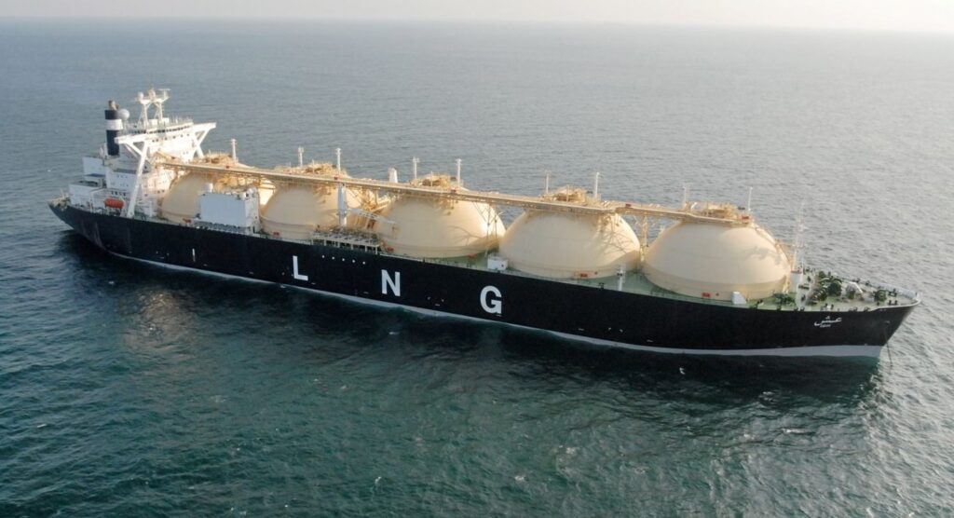
LNG Cargo Diversion Decision Engine
Structured decision framework for Europe vs Asia LNG diversion economics.
Author: Lyndon Odia | March 2026

Slide 2

Contents
1. Executive Summary
2. Decision Framework
3. Netback Methodology
4. Example Diversion Decision
5. Risk & Stress Testing
6. Rule Behavior (Historical Validation)
7. Decision Waterfall
8. Assumptions & Next Steps

Slide 3
1
Executive Summary
Author: Lyndon Odia | March 2026

Slide 4
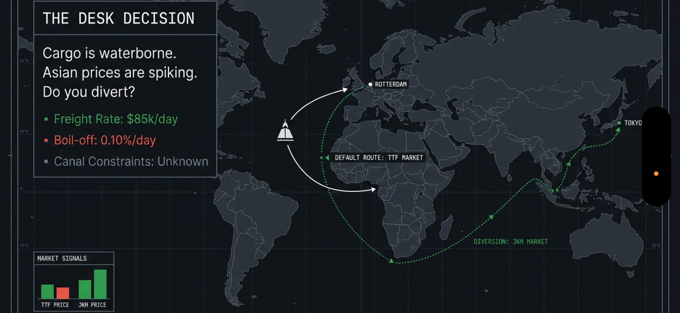
Problem
Given an LNG cargo loading in the US Gulf Should the vessel discharge in Europe (TTF) or divert to Asia (JKM)? Decision requires integrating:
Price spreads
Freight economics
Carbon costs
Operational risk buffers
Hedge execution considerations
Author: Lyndon Odia | March 2026
Notes:
What this work tries to answer is a very simple but very common LNG trading question. If an LNG cargo is loading in the US Gulf, and both Europe and Asia are potential destinations, when does it actually make sense to divert the vessel to Asia rather than keep the original Europe discharge plan? That decision is not just about looking at whether JKM is higher than TTF. You also need to consider freight economics, voyage time, boil-off, carbon costs, and operational risk. So the objective here was to build a simple decision framework that structures that call explicitly.

Slide 5
Approach
A rule-based decision engine that:
Calculates netback economics
Applies conservative risk adjustments
Generates executable hedge instructions
Validates behavior via historical rule testing
Author: Lyndon Odia | March 2026
Notes:
Read from slides.

Slide 6
Example Output
DIVERT TRIGGERED
Europe Netback | $126.26 M
Asia Netback | $133.96 M
Adjusted Uplift | $7.07 M
Hedge | BUY JKM 322 lots / SELL TTF 322 lots
Author: Lyndon Odia | March 2026
Notes:
So the objective here was to build a simple decision framework that structures that call explicitly. The model calculates Europe and Asia netbacks, applies conservative risk adjustments, and then generates a clear diversion decision together with hedge sizing. In the example shown here, the Asia netback exceeds the Europe netback by about $7.7 million before adjustments. After applying a basis haircut and an operational risk buffer, the adjusted uplift is roughly $7.07 million, which triggers a DIVERT decision. The framework also generates a hedge recommendation using JKM and TTF futures

Slide 7
2
Decision Framework
Author: Lyndon Odia | March 2026

Slide 8
Decision Framework - Market Inputs
Netback Model
Risk Adjustments
Decision Rule
Trade Ticket
Raw uplift = Asia netback – Europe netback
Basis haircut applied
Operational buffer deducted
Decision triggered only above threshold.
Author: Lyndon Odia | March 2026
Notes:
The decision framework is structured as a simple pipeline. First we take market inputs such as TTF price, JKM proxy price, freight assumptions, fuel costs and carbon prices. Those inputs feed into a netback model which calculates the delivered value of the cargo under different destination scenarios. Next we apply risk adjustments. These include a basis haircut to account for differences between physical LNG prices and hedge instruments, and an operational buffer to account for uncertainty such as port delays, weather or routing changes. After those adjustments we evaluate the decision rule. If the adjusted uplift exceeds a predefined decision buffer, the model recommends diverting the cargo. If it does not exceed that threshold, the cargo keeps its original destination. Finally the framework produces a trade ticket showing the hedge required to lock in the economics.

Slide 9
3
Netback Methodology
Author: Lyndon Odia | March 2026

Slide 10
Netback Calculation Logic
Netback
Revenue
Voyage Costs
Carbon Costs
Distance Voyage time
Revenue = Destination Price x Delivered LNG Energy
Fuel consumption
Boil-off adjustment
EUA exposure
Delivered energy
Author: Lyndon Odia | March 2026
Notes:
At the core of the model is a simple netback calculation. Netback represents the value of delivering the cargo to a specific destination after all relevant voyage costs are deducted. Revenue is calculated as the destination price multiplied by the delivered LNG energy. The delivered energy is adjusted for boil-off that occurs during the voyage. Voyage costs include charter time, fuel consumption and the duration of the voyage based on distance and vessel speed. Carbon costs are also incorporated through EUA pricing and fuel emission factors. The result is a netback for Europe and a netback for Asia. The difference between those two values is the economic incentive to divert.

Slide 11
4
Example Diversion Decision
Author: Lyndon Odia | March 2026

Slide 12
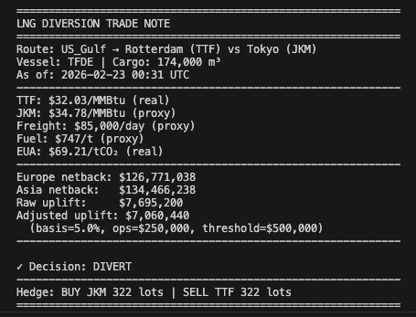
Example Trade Output
Clear decision
Hedge sizing
Adjusted uplift logic
Author: Lyndon Odia | March 2026
Notes:
This slide shows the output of the engine for a single cargo example. The route considered is US Gulf loading with potential discharge either in Rotterdam or Tokyo. Under the current assumptions the Europe netback is approximately $126 million while the Asia netback is roughly $134 million. That produces a raw uplift of about $7.7 million. After applying the basis haircut and operational buffer, the adjusted uplift is still above the decision threshold. The model therefore triggers a DIVERT decision. The hedge associated with that decision is to buy JKM futures and sell TTF futures in order to lock in the spread economics.

Slide 13
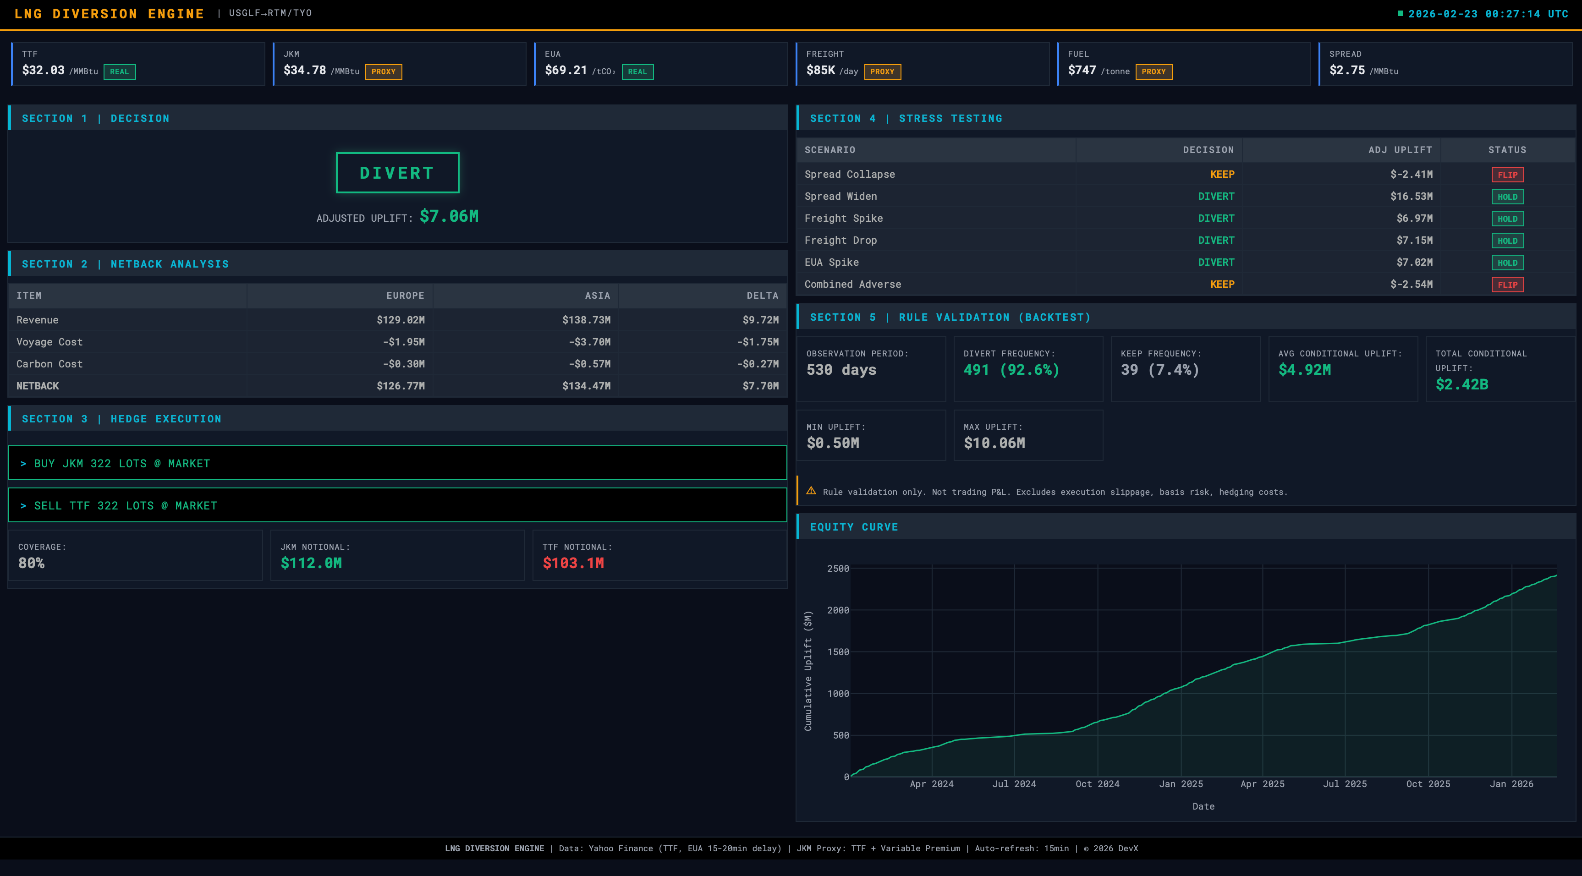
Terminal Dashboard - LNG Diversion Engine
Route: US Gulf to Rotterdam vs Tokyo
Adjusted uplift: $7.06M
Decision: DIVERT
Hedge: BUY JKM / SELL TTF
Author: Lyndon Odia | March 2026

Slide 14
5
Risk & Stress Testing
Author: Lyndon Odia | March 2026

Slide 15
Decision Robustness
Decision flips under spread collapse
Demonstrates sensitivity to freight/carbon shocks
Author: Lyndon Odia | March 2026
Notes:
A key question with any rule-based decision framework is how sensitive the decision is to changes in the market environment. To test that, the model runs a set of simple stress scenarios. For example we look at what happens if the JKM-TTF spread collapses, if freight rates spike, or if carbon prices increase. In the spread collapse scenario the adjusted uplift becomes negative and the decision flips from DIVERT to KEEP. That demonstrates that the decision rule is sensitive to the spread assumption, which is expected. Other scenarios such as freight shocks or carbon changes still leave the diversion profitable in this particular example. The purpose of this exercise is not to predict exact outcomes but to show how robust the decision is under different market conditions.

Slide 16
6
Rule Behaviour (Historical Validation)
Author: Lyndon Odia | March 2026

Slide 17
Rule Behaviour Over Time
Disclaimer: Historical simulation indicates diversion conditions frequently satisfied under proxy spread dynamics
Author: Lyndon Odia | March 2026
Notes:
To understand how the rule behaves over time, the framework was applied to historical market data. The analysis covers roughly 538 days of observations. During that period the diversion rule was triggered on around 92 percent of days. The average conditional uplift when diversion was triggered was about $4.9 million. The equity curve below shows the cumulative conditional uplift across the historical period. It’s important to stress that this is not realised trading PnL. It is simply a way to observe how often the economic conditions for diversion would have been satisfied under the model assumptions. The objective here is to understand rule behaviour rather than to claim a trading strategy.

Slide 18
7
Decision Waterfall
Author: Lyndon Odia | March 2026

Slide 19
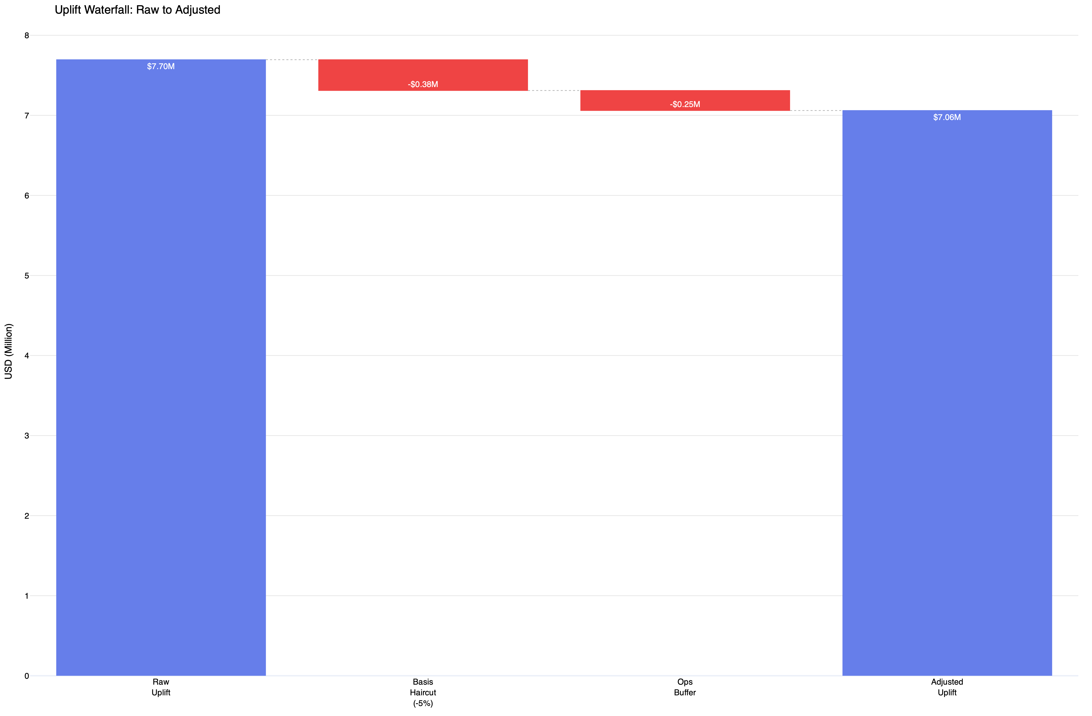
From Raw Spread to Executable Diversion Decision
Author: Lyndon Odia | March 2026
Notes:
This waterfall illustrates how the decision evolves from the initial spread to the final adjusted result. We start with the raw uplift, which is simply the difference between Asia and Europe netbacks. Next we apply a basis haircut. This reflects the fact that the physical LNG price and the hedge instruments are not perfectly aligned and that some execution slippage is inevitable. Then we subtract an operational risk buffer. This represents uncertainties such as delays, congestion or other logistical frictions that can affect the economics of a diversion.
After these adjustments we arrive at the adjusted uplift. If that adjusted value exceeds the decision threshold, the diversion is considered economically justified.

Slide 20
8
Assumptions & Next Steps
Author: Lyndon Odia | March 2026

Slide 21
Model Limitations and Future Enhancements
Limitations
Next Evolution
JKM Proxy | Licensed JKM feed
Freight Proxy | Freight curve integration
Simplified Routing | Stochastic ops delays
No demurrage modelling | Optionality modelling
Contract structure (FOB vs DES) not modelled | Contract Aware diversion logic
Author: Lyndon Odia | March 2026
Notes:
The framework intentionally keeps the modelling relatively simple, and there are several limitations worth highlighting. First, JKM prices are represented using a proxy rather than licensed Platts data. Freight rates are also simplified rather than derived from Baltic LNG freight indices. Routing assumptions are simplified and do not incorporate detailed weather routing or canal congestion models. Demurrage and port delay distributions are not explicitly modelled. Finally, the framework assumes full diversion flexibility and does not account for contract structure differences between FOB and DES cargoes. Each of these limitations suggests a natural next evolution. For example, integrating licensed JKM data, incorporating freight curves, modelling operational delays stochastically, and incorporating contract-aware diversion logic. The goal of this project was not to fully replicate a trading system but to build a structured decision framework that can be progressively extended.

